Slide 1
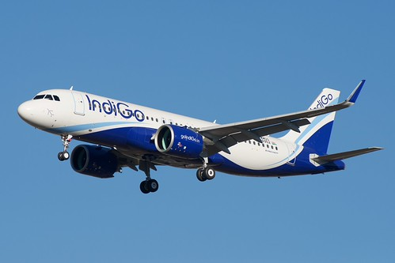
INDIGO ANALYSIS
Presented by Yogesh S.

Slide 2
Table of Contents:
Introduction
Problem Statement
Flight Operations Analysis
Crew Analysis (FDTL)
Weather Analysis
Financial Impact Analysis
Competitor Analysis
Findings
Recommendations
Conclusion

Slide 3
INTRODUCTION:
IndiGo is India’s largest airline, operating a vast domestic and international network.
In December 2025, the airline experienced a major operational disruption affecting flight schedules and customer experience.
This case study analyzes operational, financial, and external factors to understand the root cause of the crisis.

Slide 4
Problem Statement:
In December 2025, IndiGo Airlines faced a major operational crisis, resulting in thousands of flight cancellations, regulatory penalties, and increased customer refunds.
This raised critical concerns about operational efficiency and crisis preparedness.
Key Question: Was this crisis unavoidable, or could it have been predicted and prevented through better planning?

Slide 5
ON- TIME PERFORMANCE
88.1%
CANCELLATION RATE
13.89%
CANCELLED FLIGHTS
605
TOTAL FLIGHTS
4,355
AVERAGE DELAY
13.8 Mins
FLIGHT OPERATIONS KPI METRICS
A total of 4,355 flights were operated, providing a strong baseline to assess the scale and impact of the disruptions.
On-time performance still relatively high → disruption is not continuous but clustered
High cancellation rate (~14%) indicates major operational disruption
Significant number of cancellations (605 flights) → non-normal scenario
Average delays (~14 mins) show efficiency issues

Slide 6
TOTAL FLIGHTS
4,355
ON- TIME PERFORMANCE
88.1%
CANCELLATION RATE
13.89%
AVERAGE DELAY
13.8 Mins
CANCELLED FLIGHTS
605
A total of 4,355 flights were operated, providing a strong baseline to assess the scale and impact of the disruptions.
On-time performance still relatively high → disruption is not continuous but clustered
High cancellation rate (~14%) indicates major operational disruption
Average delays (~14 mins) show efficiency issues
Significant number of cancellations (605 flights) → non-normal scenario
Notes:
Cancellation Rate 13.89% -------0.5% - 1.2% On-Time Performance 88.10% -------85% - 92% Avg Delay (Mins) 13.8 Mins------ 12 - 15 Mins

Slide 7
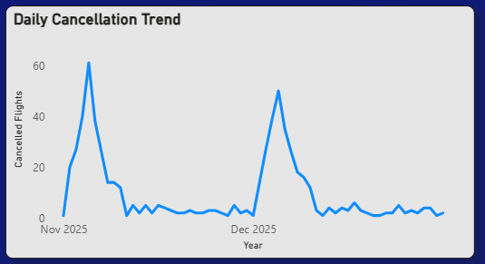
Daily Cancellation Trend
Two major spikes observed in early November (~60) and early December (~50)
Cancellations remain low and stable outside these peaks
Indicates episodic disruptions rather than continuous issues
Suggests internal operational failures (likely crew-related) during peak periods

Slide 8
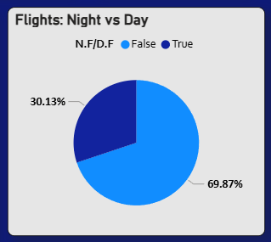
Flights: Night vs Day
Majority of flights (~70%) operate during the daytime
Night flights account for only ~30% of operations
Despite fewer in number, night flights were more prone to disruptions

Slide 9
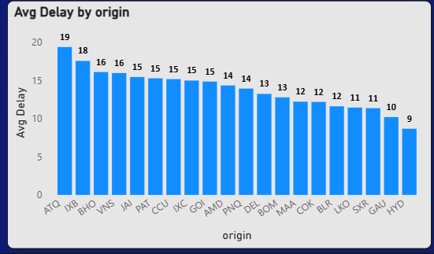
Avg Delay by Origin
Highest delays observed at ATQ (~19 mins) and IXE (~18 mins)
Most airports show delays in the range of 12–16 minutes
Lowest delays at HYD (~9 mins) and GAU (~10 mins)
Indicates location-specific operational inefficiencies

Slide 10
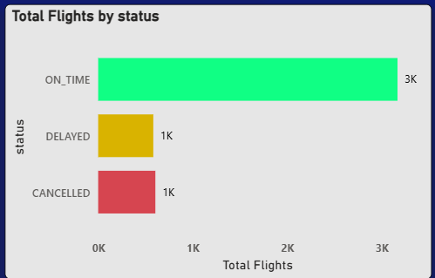
Total Flights by Status
Majority of flights (~3K) were on-time
Delayed and cancelled flights are significantly lower (~1K each)
However, the combined disruption (delays + cancellations) is still substantial
Indicates overall operations were stable but crisis impact was noticeable

Slide 11
Total Crew Records 163,459
CREW ANALYSIS KPI METRICS
“A large volume of crew records indicates extensive operations, making efficient crew management critical.”

Slide 12
Total Crew Records 163,459
Avg Rest Hours 39.26
Avg Block Hours 4.75
FDTL Violations 74.53K
Violation % 46%
“A large volume of crew records indicates extensive operations, making efficient crew management critical.”
“Although average rest hours appear sufficient, they may not consistently meet regulatory requirements.”
“Average block hours are moderate, suggesting normal flight duration but not the root cause of stress.”
“A very high number of FDTL violations indicates significant non-compliance with duty regulations.”
“Nearly half of the crew operations violated FDTL rules, clearly indicating severe crew shortage and overutilization.”
Notes:
FDTL Violation % 46.00%------ < 2% (Target)
Avg Block Hours 2.5 - 3.5 Hours 4.75 Hours

Slide 13
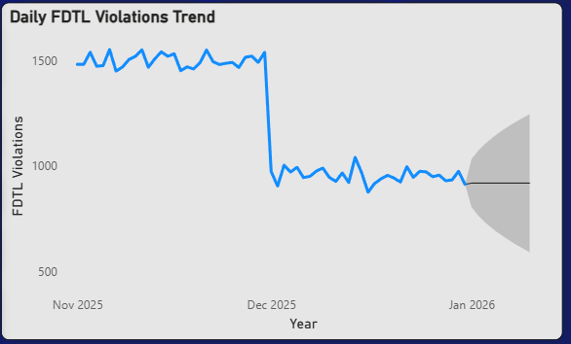
FDTL Violations Trend
High violations (~1500+) observed consistently before December
Sharp drop in violations post-December (~900–1000)
Indicates regulatory intervention or reduced crew duty hours
Drop in violations likely led to crew shortage and increased cancellations

Slide 14
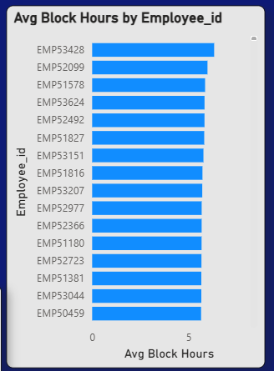
Avg Block Hours by Employee
Most employees have similar block hours (~5–6 hrs)
Indicates even workload distribution across crew
No major outliers → workload is balanced but limited
Suggests capacity constraint rather than uneven allocation

Slide 15
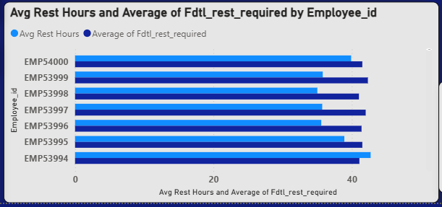
Rest Hours vs Required (FDTL)
Actual rest hours are very close to required FDTL limits
Minimal gap indicates tight compliance with regulations
Little flexibility in rest scheduling → low buffer capacity
Suggests limited scope to extend crew duty hours

Slide 16
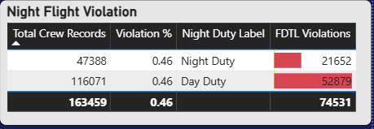
Night Flight Violations
Both day and night duties show similar violation rates (~46%)
However, day duty contributes higher absolute violations (52,879)
Night duty also has significant violations (~21,652)
Indicates violations are system-wide, not limited to night flights

Slide 17
Total Weather Records 976
Low Visibility Count 138
Avg Visibility 6.47K meters
Avg Temperature 18.18°C
Fog Count 128
WEATHER IMPACT KPI METRICS
“Temperature levels were normal and did not contribute to operational disruptions.”
“Low visibility incidents occurred but were not widespread enough to cause major disruption.”
“Sufficient weather data confirms consistent monitoring, with no extreme anomalies observed.”
“Overall visibility remained within acceptable limits for flight operations.”
“Fog events were present but relatively limited in frequency.”

Slide 18
Avg Temperature 18.18°C
Avg Visibility 6.47K meters
Fog Count 128
Low Visibility Count 138
Total Weather Records 976
“Temperature levels were normal and did not contribute to operational disruptions.”
“Low visibility incidents occurred but were not widespread enough to cause major disruption.”
“Sufficient weather data confirms consistent monitoring, with no extreme anomalies observed.”
“Overall visibility remained within acceptable limits for flight operations.”
“Fog events were present but relatively limited in frequency.”
Notes:
Avg Visibility 6.47K (6.4 km) > 5 km (Normal Ops
Fog Count 128 Records High Concentration
Low Vis Count 138 Records Frequent Disruptions
Min. Visibility Dropped to 4K < 550m (CAT III Needed)

Slide 19
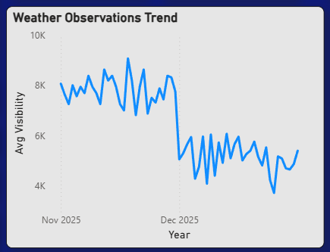
Weather Observations Trend
Visibility was relatively high (~7K–9K) before December
Sharp drop in visibility (~4K–6K) observed during December
Indicates worsening weather conditions (fog/low visibility)
However, fluctuations suggest weather was inconsistent, not extreme throughout

Slide 20
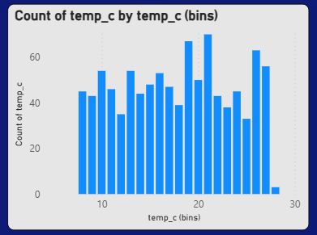
Temperature Distribution
Temperature values are mostly concentrated between 10°C and 25°C
No extreme temperature conditions observed
Distribution is fairly uniform across ranges
Indicates normal seasonal weather conditions

Slide 21
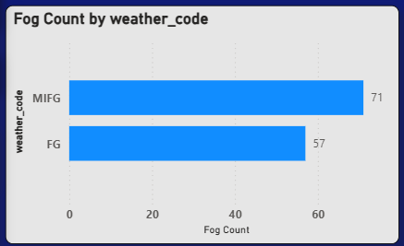
Fog Count by Weather Code
Majority of fog events are categorized as MIFG (71 cases)
FG (57 cases) also contributes significantly
Indicates frequent moderate fog conditions
Suggests visibility issues were common but not extreme

Slide 22
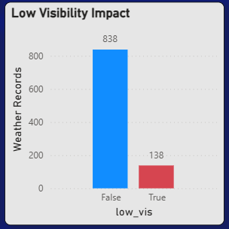
Low Visibility Impact
Majority of records (~838) show no low visibility conditions
Only a small portion (~138) experienced low visibility
Indicates low visibility events were relatively infrequent
Suggests limited overall impact on operations

Slide 23
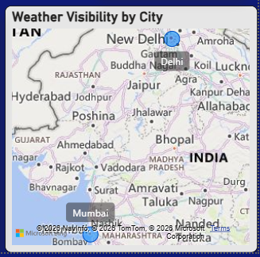
Weather Visibility by City
Visibility issues are concentrated in specific cities (not widespread)
Northern regions show relatively lower visibility conditions
Other cities maintain stable visibility levels
Indicates location-specific weather impact

Slide 24
Total Penalty ~476 Cr
Avg Load Factor 64%
Total Refunds ~126K
Total Revenue ~15,916 Cr
Avg Fare ~10,875
REVENUE ANALYSIS KPI METRICS
highlight serious regulatory and operational failures.
shows pricing remained consistent during disruption
indicates poor seat utilization and operational inefficiency.
indicates strong demand despite the crisis.
reflects significant cancellations and customer impact.

Slide 25
Total Revenue ~15,916 Cr
Total Refunds ~126K
Avg Fare ~10,875
Avg Load Factor 64%
Total Penalty ~476 Cr
shows pricing remained consistent during disruption
indicates poor seat utilization and operational inefficiency.
highlight serious regulatory and operational failures.
indicates strong demand despite the crisis.
reflects significant cancellations and customer impact.
Notes:
Load Factor (Occupancy) 88.00% -------82% - 85%

Slide 26
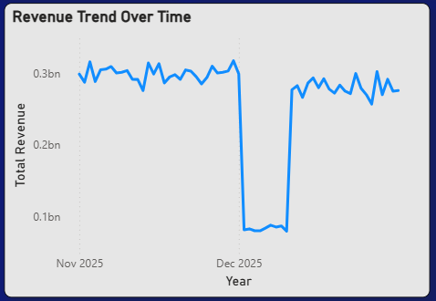
Revenue Trend Over Time
Revenue remained stable (~0.28–0.32 bn) before December
Sharp drop observed in early December (~0.08 bn)
Gradual recovery seen after the dip
Indicates direct financial impact during crisis period

Slide 27
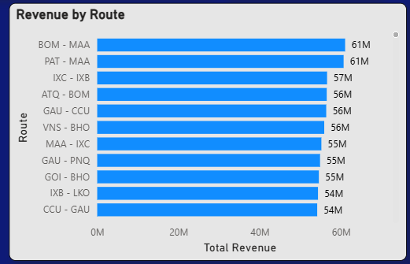
Revenue by Route
Top routes like BOM–MAA and PAT–MAA (~61M) generate highest revenue
Revenue distribution across routes is fairly balanced (~54M–61M)
No single route dominates → diversified revenue streams
Indicates consistent demand across multiple routes

Slide 28
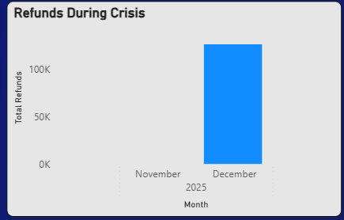
Refunds During Crisis
Refunds are significantly higher in December
Minimal or no refunds observed in November
Indicates direct impact of crisis period on customer cancellations
Reflects increased financial burden during disruptions

Slide 29
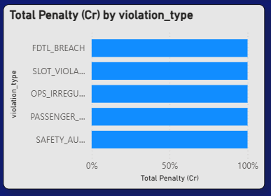
Total Penalty by Violation Type
Penalties are distributed across multiple violation types
No single violation dominates → system-wide compliance issues
Includes FDTL breaches, slot violations, and operational irregularities
Indicates broad operational inefficiencies across functions

Slide 30
Competitor Cancellation % 2.77%
Competitor Avg Delay 13.01 mins
Incident Count 2,000
Flights Affected 47K
Competitor Flights 2,928
COMPETITOR ANALYSIS KPI METRICS
“Average delays among competitors are similar or slightly lower, indicating stable operational performance.”
“Competitor cancellation rates are significantly lower (~2–3%) compared to IndiGo (~14%), showing no industry-wide disruption.”
“A substantial number of flights operated by competitors indicates stable industry activity.”
“Incidents occurred across airlines, but were handled efficiently without escalation.”
“Although incidents impacted flights, the scale was managed without major disruption.”

Slide 31
Flights Affected 47K
Competitor Avg Delay 13.01 mins
Incident Count 2,000
Competitor Cancellation % 2.77%
Competitor Flights 2,928
“A substantial number of flights operated by competitors indicates stable industry activity.”
“Although incidents impacted flights, the scale was managed without major disruption.”
“Average delays among competitors are similar or slightly lower, indicating stable operational performance.”
“Incidents occurred across airlines, but were handled efficiently without escalation.”
“Competitor cancellation rates are significantly lower (~2–3%) compared to IndiGo (~14%), showing no industry-wide disruption.”

Slide 32
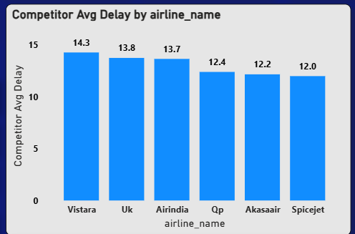
Competitor Avg Delay
Competitor delays range between 12–14 minutes
Vistara (~14.3 mins) has the highest delay among competitors
SpiceJet (~12 mins) shows the lowest delay
Overall delays are consistently low across competitors

Slide 33
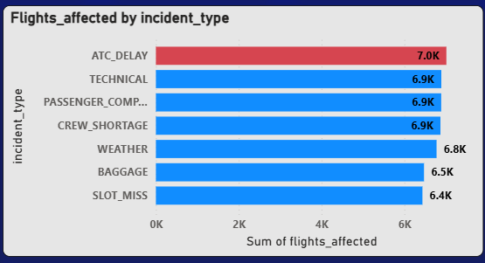
Flights Affected by Incident Type
ATC delays (~7K) are the highest contributor
Technical issues, passenger issues, and crew shortage (~6.9K each) are also major factors
Weather impact (~6.8K) is slightly lower compared to operational causes
Indicates disruptions are multi-factor but dominated by operational issues

Slide 34
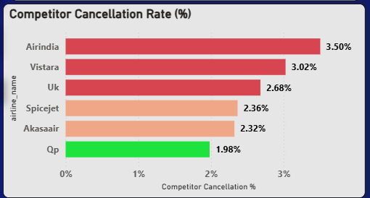
Competitor Cancellation Rate
Competitor cancellation rates remain low (2%–3.5%)
Air India (~3.5%) is the highest among competitors
QP (~1.98%) shows the lowest cancellation rate
Overall industry shows stable operations with minimal disruption

Slide 35
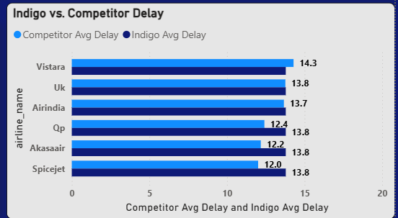
IndiGo vs Competitor Delay
IndiGo’s average delay (~13.8 mins) is consistently higher than most competitors
Competitors maintain delays between 12–14 mins
Gap is especially visible against QP, Akasa, and SpiceJet
Indicates relative inefficiency in operations compared to peers

Slide 36

Key Findings
High FDTL violations (~46%) indicate poor crew planning
Reduction in violations led to crew shortage and cancellations
Revenue dropped significantly during crisis period
Refunds and penalties increased, causing financial loss
Flight cancellations occurred in sharp spikes (episodic disruptions)
Weather impact was present but not the primary cause
Competitors maintained low delays and cancellation rates
Issues were internal and operational, not industry-wide

Slide 37


Improve crew planning and scheduling systems
Maintain buffer crew capacity for peak demand
Optimize night flight operations
Implement real-time disruption monitoring system
Strengthen operational contingeny planning
Reduce dependency on last-minute crew allocation
Enhance regulatory compliance planning (FDTL)
RECOMMENDATIONS
CONCLUSION:
“The crisis was predictable and driven by internal inefficiencies, primarily in crew management and operational planning.”

Slide 38


